Slide 1
Japanese 111
Instructor name

Slide 2
Why are you learning Japanese at XXX?
To be able to watch Anime/read manga/movie in Japanese and understand.
To be able to go to Japan and get around.
To be able to communicate better with Japanese students on campus
For future career
Not to be a monolingual/to try non-European language
Notes:
学生がよく言う日本語を勉強する理由のリスト

Slide 3
Why are you learning Japanese at XXX?
To be able to communicate using Japanese
  Interpretive (reading, listening)
  Presentational (writing, speaking)
  Interpersonal communication
The class will give you the opportunity to practice ALL skills!!
Notes:
「日本語ができる」ということは、これらのスキルが全て身につくということ。学生の動機が「アニメの日本語がわかるようになりたい」だったとしても、全部のスキルを練習しなければなりません！

Slide 4
Why are you learning Japanese at XXX?
To be able to communicate using Japanese
  Interpretive (reading, listening)
  Presentational (writing, speaking)
  Interpersonal communication
The class will give you the opportunity to practice ALL skills!!
Most of you cannot practice outside of class
= We want to maximize your in-class practice time!
Notes:
学生に説明：Especially, Interpersonal communication skills cannot be practiced alone and most students do not have the opportunity to practice it outside of class. This means we need to maximize our in-class practice time.

Slide 5
Changes in Language Classrooms
In the past | Today (21st century classroom)
Students learned about the language (grammar) | Students learn to use the language
Focused on isolated skills (listening, speaking, reading, and writing) | Focus on the three modes: Interpersonal, Interpretive, and presentational
Teacher-centered class | Learner-centered with teacher as facilitator/collaborator
Emphasis on teacher as presenter/lecturer | Emphasis on learner as “doer” and “creator”
Only the teacher knows criteria for grading | Students know and understand criteria on how they will be assessed by reviewing the task rubric
Students “turn in” work only for the teacher | Learners create to “share and publish” to audiences more than just the teacher.
Notes:
学生に説明：今までの先生の話を聞くスタイルのクラスに慣れているかもしれないが、21st centuryの若者がこの先必要なスキルを身につけるために、教室での学生と教師の役割は変化してきている。この日本語のクラスでも学習者として教室内で上の役割を果たすことを心にとめること。

Slide 6
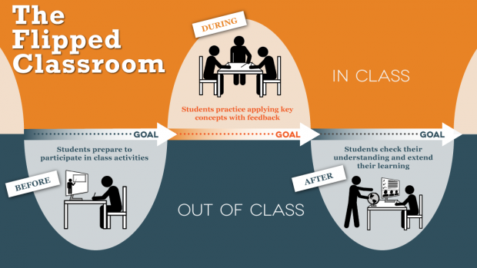
Flipped Class
http://ctl.utexas.edu/teaching/flipping-a-class
Notes:
学生に反転授業の進み方について説明。反転授業が学生の授業内での活動・練習時間を最大化＆効率的にするためにとても効果的であることを強調。クラス活動を実のあるものにするため（自分のためにも、クラスメートのためにも）には、授業前に講義ビデオを見てクイズを受けてくることがとても重要であることを強調。

Slide 7
Semester Flow
Week 1 (lecture + in- class practice + Workbook)
Week 1 Th~Week15 (Flipped)
Grammar video
Online quiz
In-class activities
Workbook
Google Sites Project
Writing & Oral Presentation
Notes:
学期の流れの例。第一週はあいさつとひらがな中心。ビデオは一週目後半または二週目から。

Slide 8
Keys to successful learning in Japanese class at XXX
Remember that you are responsible for your own learning.
Make sure to watch grammar videos, take the quiz and bring questions. Do your after-class homework.
You improve your skills to apply knowledge by practicing on application. = actively participate in class activities. This is where you get to practice before you use it in real world!

Slide 9
Keys to successful learning in Japanese class at XXX
Use as much Japanese as possible in class.
Study/review every day and maximize productivity in class (JPN is a Group IV language: 480 hours will get you somewhere between Novice – Intermediate… JPN111 at UNR=50 contact hours)

Slide 10
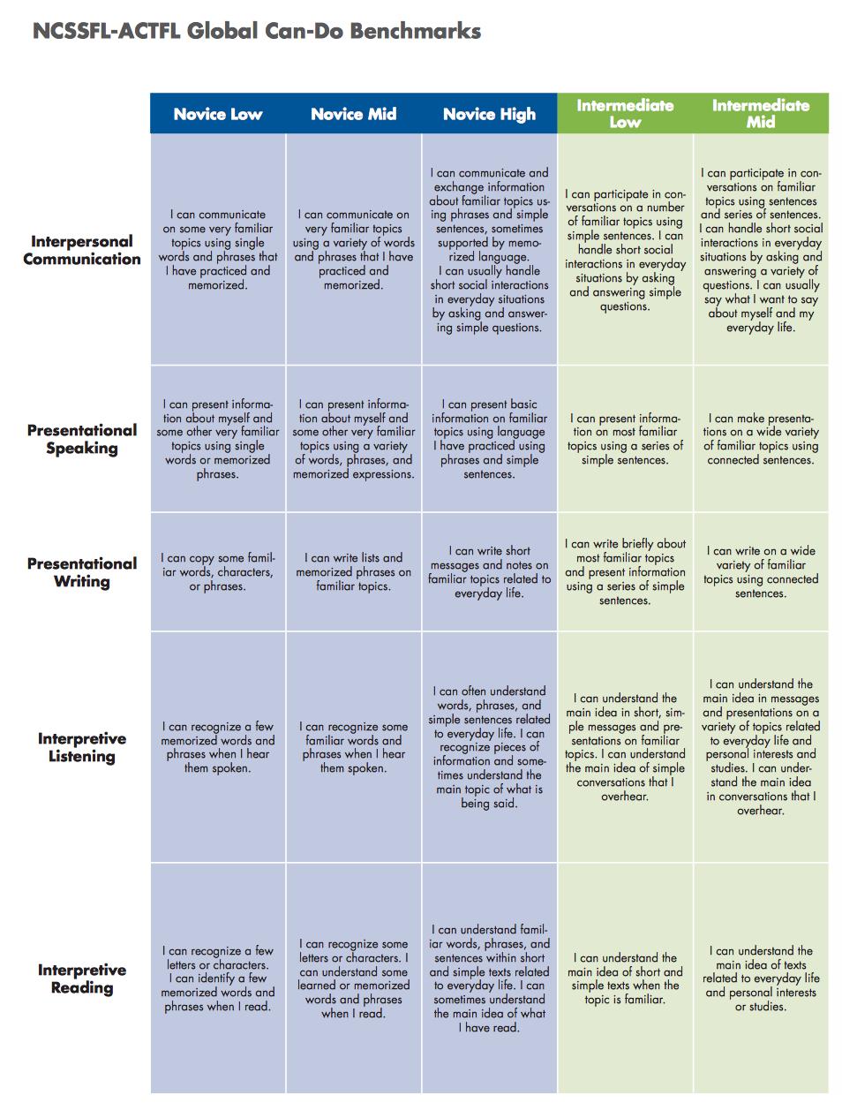
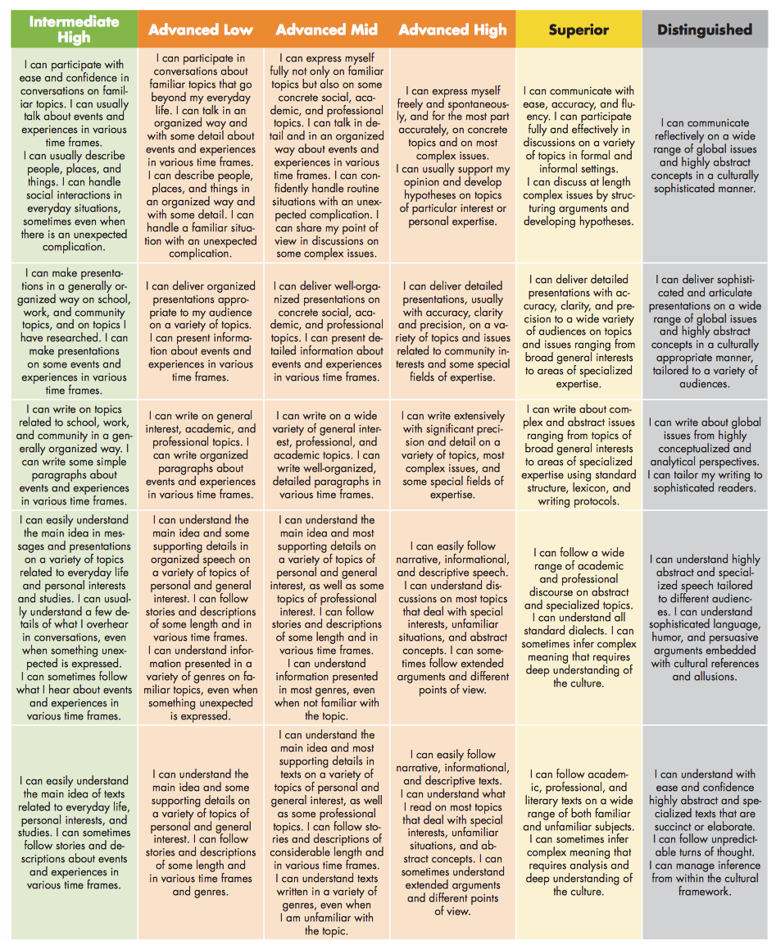
Notes:
学生にどれだけ練習時間が必要かを自覚させる
Group IV Languages: Including Arabic, Chinese, Japanese, Korean…
Length of Training Minimal Aptitude Average Aptitude Superior Aptitude
16 weeks (480 hours) Novice High Intermediate Low Intermediate Low/Mid
24 weeks (720 hours) Intermediate Low/Mid Intermediate Mid/High Intermediate High
44 weeks(1320 hours) Intermediate High Advanced Low Advanced Mid/High
80-92 weeks (2400-2760 hours) Advanced High Superior Superior
At UNR…
50min x 4 x 15 weeks = 3000 min = 50 hours only!! We need to practice as much as possible in class, and you should try spending as much time practicing outside, too!!

Slide 11
Flow of a class (50min)
(5-10 min) English: English Q&A time/Vocab/Kanji
NOT a re-teaching of the video lecture
(30-35 min) Japanese: Grammar activities
(5-10min) Workbook activities
Notes:
授業の流れの例

